Slide 1
Mean Shifting
حسين علي إبراهيم الشامي

Slide 2
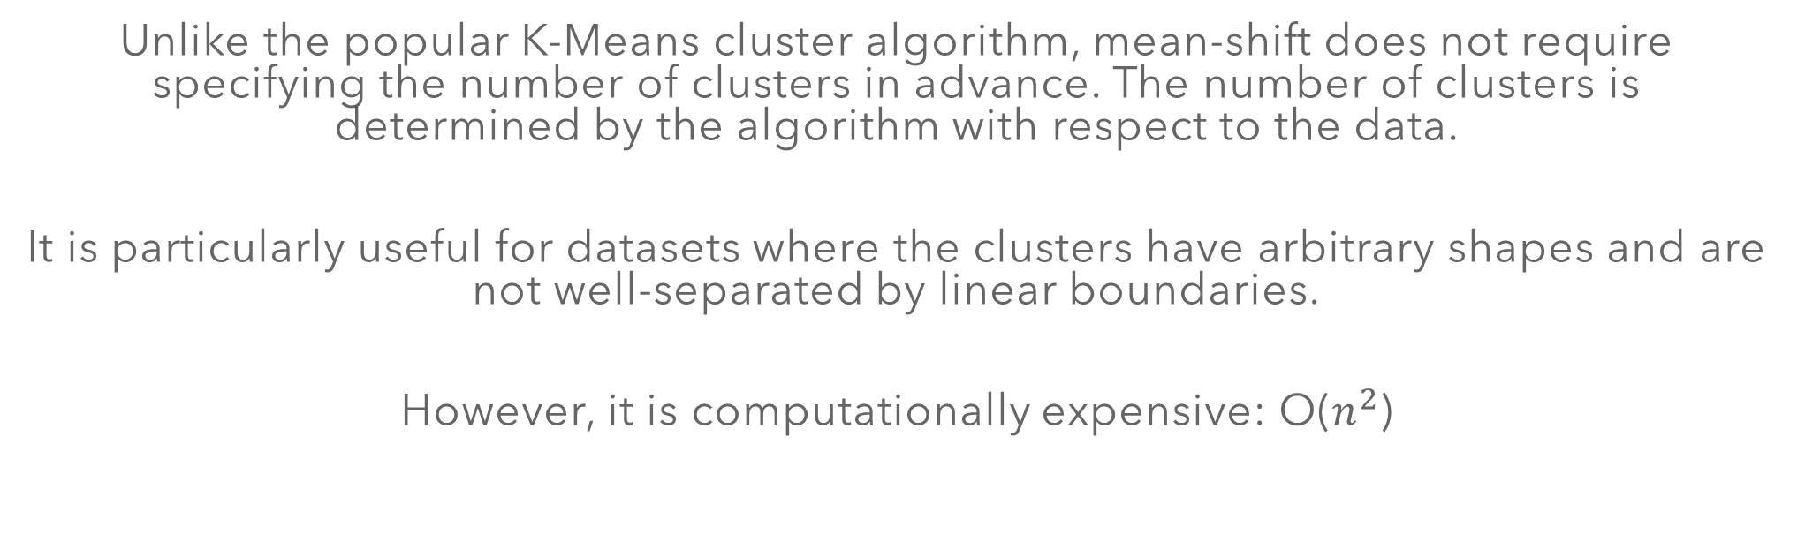
Mean Shifting Algorithm
Unlike the popular K-Means cluster algorithm, mean-shift does not require specifying the number of clusters in advance. The number of clusters is determined by the algorithm with respect to the data.
It is particularly useful for datasets where the clusters have arbitrary shapes and are not well-separated by linear boundaries.
However, it is computationally expensive: O($n^{2}$)

Slide 3
-
The basic idea behind mean-shift clustering is to shift each data point towards the mean (i.e., the highest density) of the distribution of points within a certain radius.
The algorithm iteratively performs these shifts until the points converge to a local maximum of the density function.
Mean-Shift clustering can be applied to various types of data, including image and video processing, object tracking and bioinformatics.

Slide 4
Kernel Density Estimation
KDE moves the data points towards their region’s mean
Mean-shift builds upon the concept of kernel density estimation, in short KDE. This estimates how the data points will move.

Slide 5
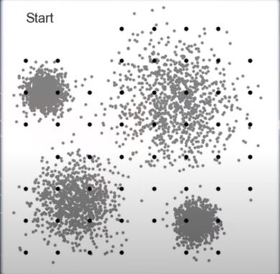
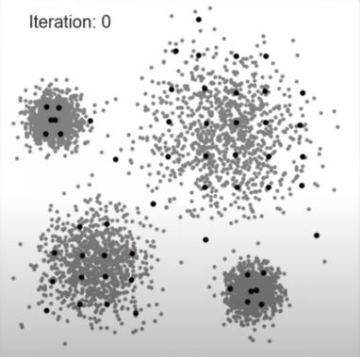
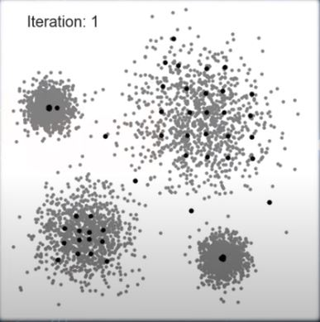
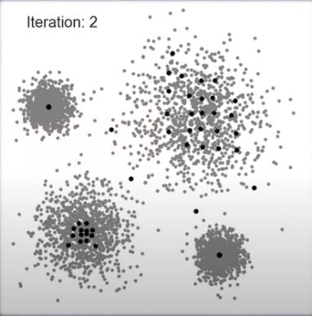
Example
Mean Shifting iterates until a convergence is reached, or iteration limit reached.

Slide 6
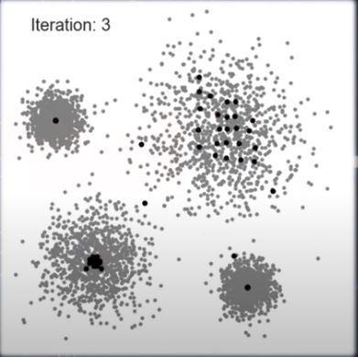
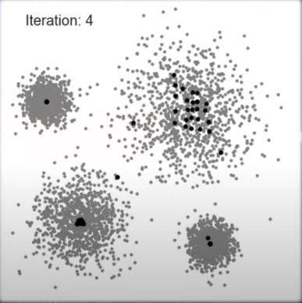
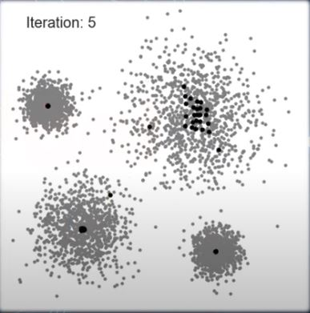
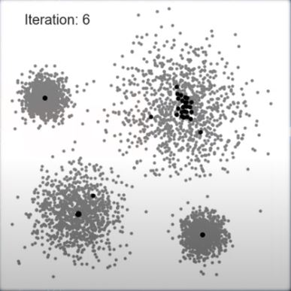
Example

Slide 7
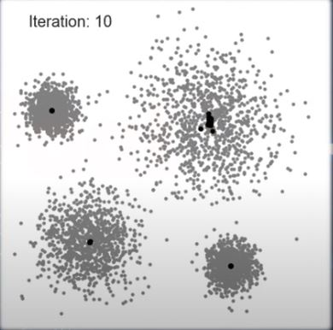
Final Result: Data Point Converge

